Slide 1
Faculty / TA Orientation Workshop
July 2026

Slide 2


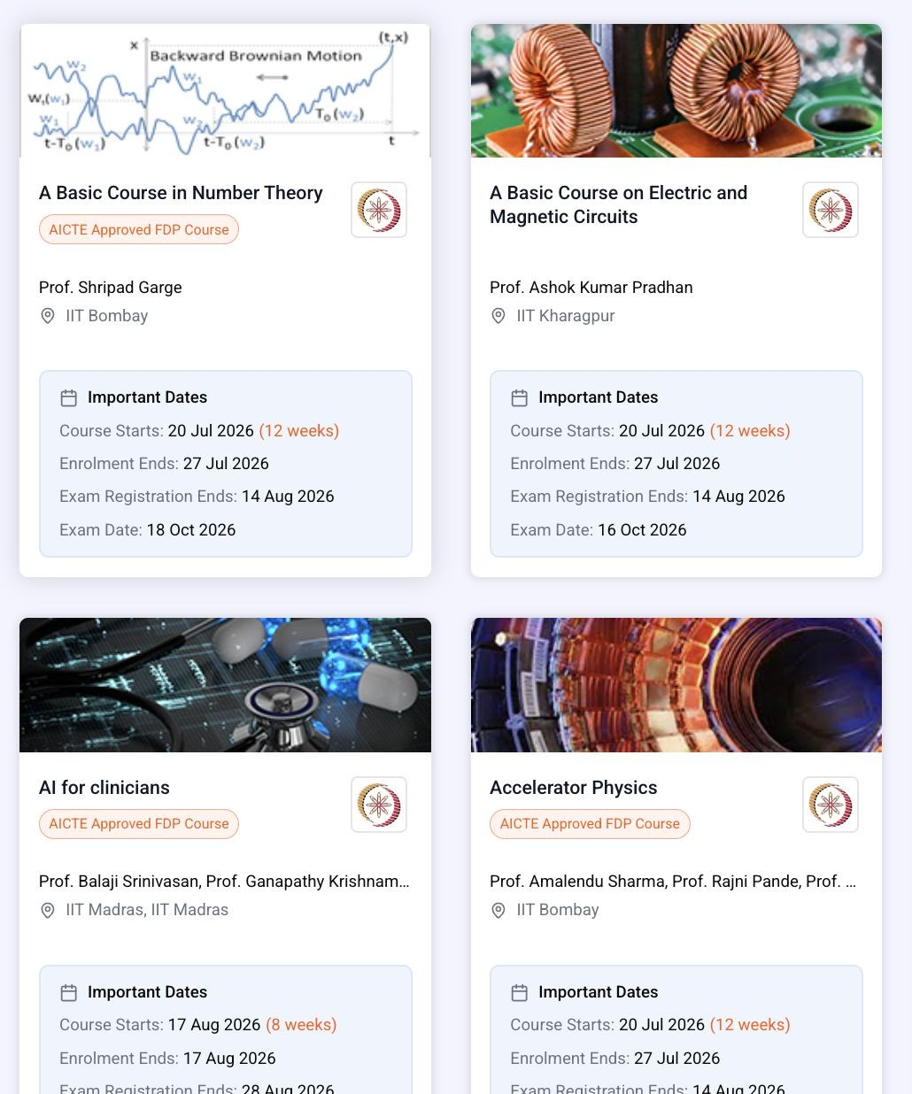

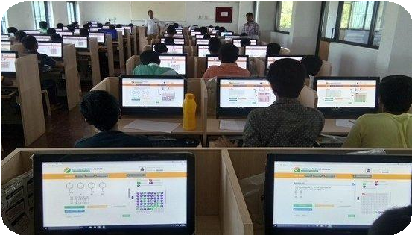
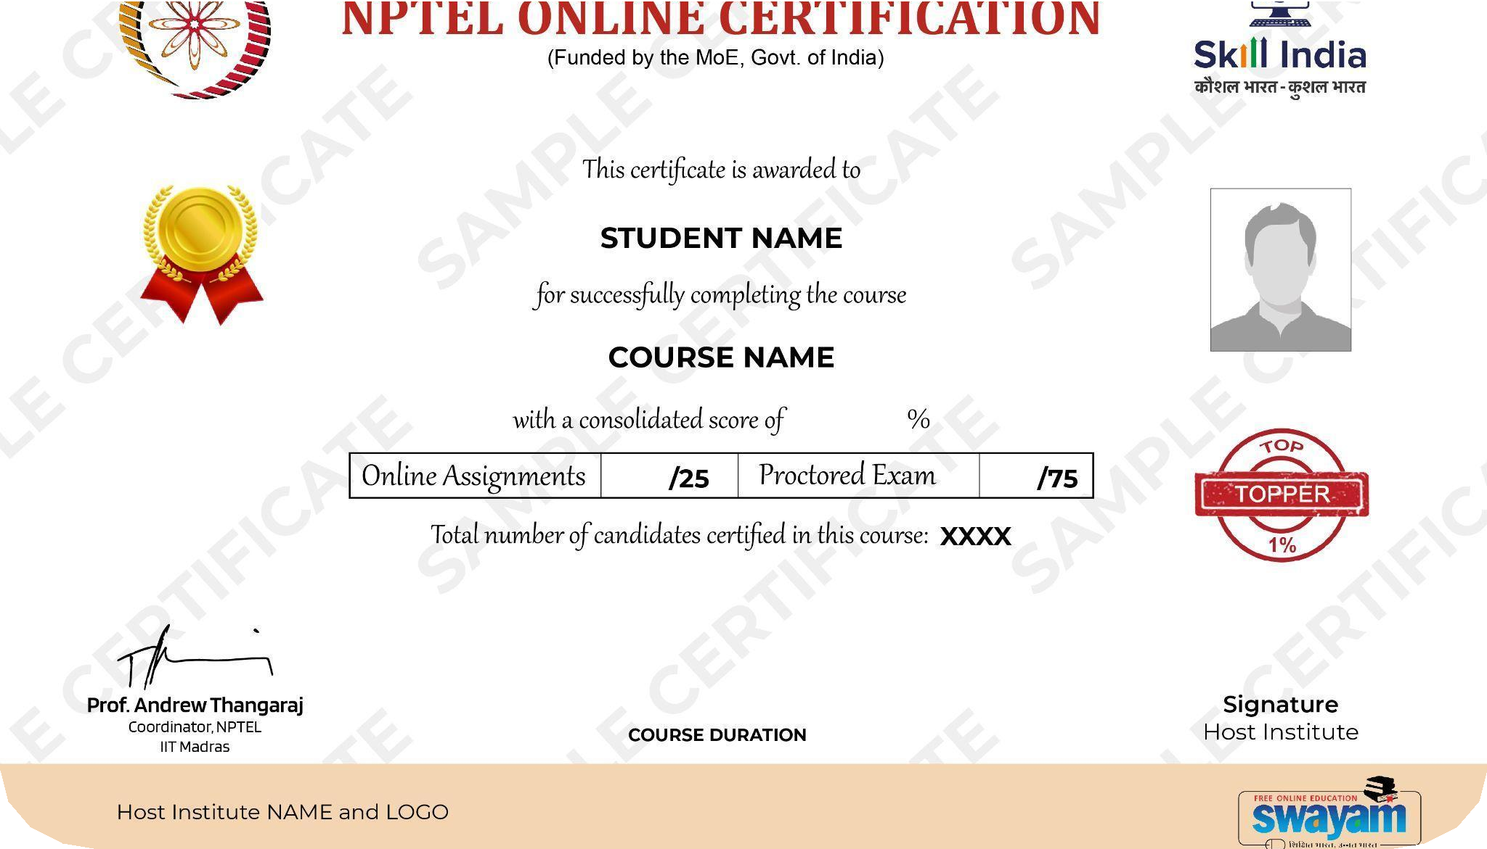
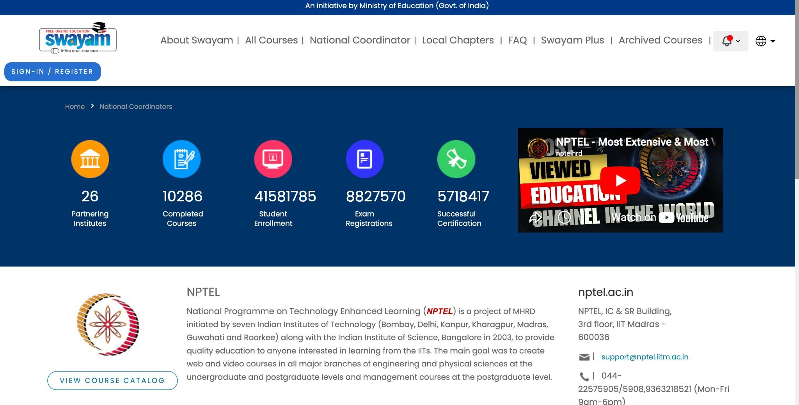

NPTEL ONLINE CERTIFICATION (NOC), SINCE 2014
10,286
Courses offered
on Swayam
4.16 Crore
Enrollments
(No fee)
57.2 Lakhs
Certified
e-verifiable Certificates
88.27 Lakhs
Exam registrations
Proctored Exam (Optional)
httpз://оnlineсоurзeз.nptel.aс.in

Slide 3


FROM MAR 2014 – JUN 2026
Jan 2026 Sem: 36.8+ lakhs enrollments,
12.6+ lakhs exam registrations
12.6
21.3
EXAM
17.29
4.6 Covid Impact
REGISTRATIONS
2.46 Covid
7.49
11.9
2
Impact
(in lakhs)
5.17
5.09
4.57
1.14
2.48
0.09
0.48
1794 COURSES
0.03
1354 Courses
1452 Courses
973 Courses
168
COURSES
289
COURSES
495
COURSES
650
COURSES
810
COURSES
1028
COURSES
1212
COURSES
3
COURSES
54
COURSES
2014 |  | 2015 | 2016 |  | 2017 | 2018 |  | 2019 | 2020 |  | 2021 | 2022 |  | 2023 | 2024 |  | 2025 | 2026
1.1 |  | 2.4 | 6.4 |  | 15.8 | 22.6 |  | 34.5 | 41.9 |  | 33.6 | 40.5 |  | 52.2 | 57.2 |  | 65.4 | 36.8
Jul-Dec 2026
1054 Courses
Enrollments
6.40 lakhs+ (Ongoing)
ENROLLED (in lakhs)
Exam registration (Ongoing)

Slide 4
A Summary of NPTEL Activities
Largest Contributor on SWAYAM
1054 courses proposed for July 2026 semester
Running of SWAYAM portal
Zero downtime since NPTEL took over SWAYAM portal operations
Cost at ~Re. 1 per enrolled student per month
Manage the SWAYAM local chapter colleges
8400+ colleges/universities are local chapters
Local chapter has roles on portal for monitoring course participation
Local chapter SPOC workshops held every semester across IITs
Regional language translation
80063+ translated hours for 3000+ courses

Slide 5
Factors Contributing to Success of NPTEL
Faсulty-сentriс зuppоrt for content creation, portal, course delivery
Active, effective mоnitоring оf соurзe delivery
Weekly assignments in all courses
Dashboard with assignment submissions and grades
Forum and assignment data monitoring
Examinatiоnз: Verify outcomes, establish value for certiﬁcation
Quality control is a critical part of NPTEL’s success
Steady growth in exam registration
Aсademiс rigоur: Important consideration for credit transfer
Cоmmunity
Active involvement of local chapters (SPoC and Mentors)
Acknowledgement of well-performing local chapters

Slide 6








INTERNSHIPS FOR TOPPERS
Course offering faculty have to consent to take interns during the summer or winter
NPTEL will reach out to the toppers of the course asking them to apply - resume, SOP
Faculty chooses from the pool
NPTEL sends confirmation
Internship - in person at the institute/online
Stipend and certificate from NPTEL on successful completion of internship
https://nptel.ac.in/internship

Slide 7
Internships-Summary
Status | Winter 2022 | Summer 2023 | Winter 2023 | Summer 2024 | Winter 2024 | Summer 2025 | Winter 2025 | Summer 2026
Applied | 50 | 235 | 103 | 1275 | 300 | 1817 | 3477 | 4363
Joined | 44 | 195 | 76 | 204 | 140 | 406 | 1682 (Offered) | 452 (Offered)
Complete d | 44 | 144 | 68 | 92 | 85 | 319 | 820 (Completed so far) | Ongoing

Slide 8

1. POST BAC FELLOWSHIPS - OPPORTUNITY TO WORK WITH TOP FACULTY AT IITS
Fellowship Details: Project Selection Process:
Duration: 1 year
Eligibility: NPTEL stars
Stipend: Rs 25,000+HRA per month for stars with UG/PG degrees
Contingency of Rs 1 lakh for 1 year
Location: In-person at the chosen institute
Collect project opportunities and academic requirements from the Faculties
Shared the compiled list of projects with NPTEL stars.
Student Selection: Faculty will go through the resumes and videos submitted by the learners and may conduct an interview to select the candidates.

Slide 9
POST BAC FELLOWSHIPS - PROJECT DETAILS (INSTITUTE-WISE)
Institutes | No. of Projects
 | 2024 | 2025 | 2026
IISc Bangalore | 3 | 7 | 30
IIT Bombay | 8 | 7 | 34
IIT Delhi | 4 | 1 | 12
IIT Guwahati | 15 | 17 | 69
IIT Kanpur | - | 7 | 23
IIT Kharagpur | 33 | 22 | 104
IIT Madras+Other | 12 | 36 | 193
IIT Roorkee | 28 | 18 | 86
Total | 103 | 115 | 551
Total students Applied for 2026:
1041

Slide 10
PMRF Research Scholars – Value Addition as NPTEL TAs
PMRF Scholar’s role is in addition to regular NPTEL TAs
Online Live interaction with course students
Problem solving and doubt-clearing for weekly content
History
Piloted in Jan-April 2022, with 80 PMRF fellows – Well-received by students
Expanded to 370 (July 2022), 466 (Jan 2023), 371(July 2023), 418(Jan 2024),
395(July 2024), 362(Jan 2025), 245(July 2025), 195(Jan 2026)
Overwhelming response to the live sessions and mostly positive learner feedback
Some norms
Part of their PMRF work: No additional honorarium
Does not replace the existing TA system
Conduct live sessions each week for the course she/he is alloted.
Can also work as regular NPTEL TA (with honorarium)
Faculty can opt to not have any PMRF TA
More than one PMRF TA for large classes

Slide 11
Copyright Guidelines
NPTEL contents are distributed under the CC-BY-NC-SA license(Attribution-NonCommercial-ShareAlike)
You can use the material from another source (image, video, article, book, etc.)
under the following terms
Attribution - You must give appropriate credit , provide a link to the license, and indicate if changes were made. You may do so in any reasonable manner, but not in any way that suggests the licensor endorses you or your use.
NonCommercial - You may not use the material for commercial purposes.
ShareAlike - If you remix, transform, or build upon the material, you must distribute your contributions under the same license as the original.

Slide 12
Copyright Guidelines
Avoiding plagiarism: Acknowledge the original source
Avoiding copyright violation: Permission to reuse or reinterpret original content
Journal Papers: Please link the DOI or the original Journal site
Video content
Do not embed other videos (YouTube or otherwise)
Provide link instead, so that learners can view them independently
Video can be used after appropriate copyright permissions from the original source

Slide 13
Course and its contents

Slide 14
Types of Assignment Questions: Auto-Graded
Multiple choice / Multiple select questions (MCQ / MSQ)
Numerical (Fill in the blanks / Objective / Short Answer)
Alphanumeric (Fill in the blanks / Objective / Short Answer)
Numeric Array
Programming assignments

Slide 15
Types of Assignment Questions: Auto-Graded
Multiple choice / Multiple select questions (MCQ / MSQ)
Single correct (MCQ) or multiple correct (MSQ) answers possible
Avoid using “none of the above” / “all of the above”
We recommend ﬁve or more choices (random guess ≤ 20%) in MCQ, when possible
Numerical (Fill in the blanks / Objective / Short Answer)
Alphanumeric (Fill in the blanks / Objective / Short Answer)
Numeric Array
Programming assignments

Slide 16
Types of Assignment Questions: Auto-Graded
Multiple choice / Multiple select questions (MCQ / MSQ)
Numerical (Fill in the blanks / Objective / Short Answer)
Answer: Exact-type or Range-type
Range is preferred to allow for approximations
Choose the range based acceptable errors (e.g., Range: 1.71 to 1.73, if ±0.01)
Ensure suﬃcient range to accommodate reasonable approximations
Alphanumeric (Fill in the blanks / Objective / Short Answer)
Numeric Array
Programming assignments

Slide 17
Types of Assignment Questions: Auto-Graded
Multiple choice / Multiple select questions (MCQ / MSQ)
Numerical (Fill in the blanks / Objective / Short Answer)
Alphanumeric (Fill in the blanks / Objective / Short Answer)
Assignments:
Exams:
Exact Match | Contains | Starts with | Comma-separated keywords Only exact match is available
Numeric Array
Use this to conﬁgure vector / matrix / array type answers
Programming assignments
Supports: C, C++, Java, Python, Verilog, Perl, Haskell

Slide 18
Types of Assignment Questions: Manual Grading
Submission options
Document upload
Essay-type questions
Grading options
Manual grading
Peer-reviewed / Rubric-based grading
How Manual Grading works
Add Course Staff before making the assignment public
Course staff are responsible for evaluating the subjective assignments
Evaluation deadline is two weeks after assignment due date
Course Staff must enter total marks out of 100, before evaluation deadline
Scores entered on the portal will be visible to the students
Avoid subjective assignments for the ﬁrst two weeks of the course

Slide 19
NPTEL Online Courses: Do's and Don’t’s for NPTEL Assignments
Things to Avoid in Assignments (and what to do instead)
Most common error: Giving Incorrect Answers as Correct Answers
Which of the following are prime numbers
(a) 2 (b) 3 (c) 10 (d) 15
Another common error: Not giving correct option in MCQ
2. Which of the following are prime numbers
(a) 4 (b) 6 (c) 10 (d) 1S
Please get the questions independently verified by a TA.
For example, if TA-1 has not formulated the questions and/or configured on NPTEL website, then ask TA-1 to solve and verify the answers on NPTEL website.
Please avoid excessive use of "none/all of the above"
Which of the following are prime numbers
(a) 2 (b) 3 (c) All of the above (d) None
Use "All" or "None" only for pedagogical reasons.
Avoid using "AND" and "None" in the same question
Avoid using it when you don't have a good third/fourth choice
Numerical questions: Prefer giving a range when possible
4. The value of sin(n) is
0 (Avoid, as sin(3.1415) in calculator is not 0) Ans. Range: —0.001, 0.001
Things to Avoid in Assignments (and what to do instead)
Good practice: is to sort the solutions in either ascending or descending order
Common causes of confusion for students: Ambiguous; Using qualifiers like "most”/“some"; or rely on personal experience
5. Which number is not identified as prime by most students?
(a) 2 (b) 3 (c) 10 (d) 15
Be careful when preparing such question. It may be confusing for two reasons: (ij "some" or "most" makes it ambiguous; and (ii) some students may mark 15 as "not identified as prime" (experience based!)
Text-based auto-graded questions: Be careful!!
6. Name the capital of India
Ans. New De1h1 (Think about extra spaces, capitalization, etc.)
Consider using regular expressions for such questions
Regular Expression Answer: de1h1 or De1h1
Note: any solution containing Delhi is marked right (incl. Purani Delhi :-)
Using text answers for numerical questions to be avoided
7. The result of vector multiplication: v = 2”[1 2 3] is:
Ans. Text: {2 , 4 , 6)
Use "Question Group" instead:
The value of v(1) is: 2
The value of v(3) is: 6

Slide 20
Rescoring of Assignments
Summary: Too many errors in the assignments conﬁgured on the online Portal
Solution: TAs to carefully check all solutions as conﬁgured on the portal Give enough time for NPTEL oﬃce to conﬁgure and TAs to verify
Why?
Errors take time to handle
For each error: (i) The assignment is made private; (ii) solution are changed;
(iii) re-grading job is started; (iv) announcement is posted
Errors are expensive
Approximately Rs. 25,000 to 50,000 per week
Errors are a reﬂection of our quality
When students ask queries about their exams, they say that if there were errors in the assignments, how sure are we that exam questions are error-free.

Slide 21
MATLAB software in your course
MathWorks, the developer of MATLAB and Simulink, is partnering with NPTEL to provide support for online courses.
MathWorks will collaborate with NPTEL course teams on their online courses that include programming tasks.
This support includes video tutorials for basic MATLAB skills, technical support on discussion forums, and a free MATLAB license for the duration of the course.
This has worked quite well in the last 13 semesters.
Incase, if your course will require access to Matlab software and we can put you in touch with the Mathworks team who will guide you on the setup and access and also help with forum questions related to this.
We have sent out an email already on this, Please revert to us if your course required MATLAB Access.

Slide 22
Best Practices

Slide 23
Best Practices: Videos and Interactions
For every 10 minutes of the video
Create 2-3 questions that the learner can use for self evaluation
Will be conﬁgured below the video and not graded but just used for self test.
Oﬃce Hours
One hour per week on a live session (with consent of instructor) to answer questions about the assignment that just got closed or about upcoming assignments
Faculty available online during these “oﬃce hours” for doubt clearing.
Discussion Forum
Introduce yourself on the forum
Check the forum twice everyday and answer the queries raised
If there are not many queries, ask questions to start discussion.

Slide 24
Best Practices: Weekly Assignments
Assignments
Please have TAs check carefully before assignments go live
If there are errors / queries after the deadline, please address them quickly
Numeric Answers: Use a reasonably wide range to accommodate rounding errors
All assignments must be multiple submission enabled.

Slide 25
Best Practices in Descriptive Courses (1 of 2)
Descriptive courses do not lend themselves as easily to the large scale and auto-graded format of online courses.
But there are a lot of best practices we have learnt over the last eight years
Use a greater share of MSQs than MCQs
Use more choices in MCQs (Caveat: Ensure these are real choices)
Comprehension questions and Grouped questions are very powerful!
Use comprehension passage followed by a few linked questions
Identify parts of an image / Match-the-columns
Email nkaisare@nptel.iitm.ac.in for suggestions on your favorite question
New question types can be added, but with a lead time of about 6 months!

Slide 26
Best Practices in Descriptive Courses (2 of 2)
Essay-type questions
We normally have a few essay type questions on the ﬁnal exam paper. Avoid surprises so that students stand a good chance to succeed
Announce this in advance
Conﬁgure essay-type questions in a few assignments to get them to practice
Prefer essay-type questions in the latter half of your course
Create some notes to share as sample answers expected for the essay type questions in the course.

Slide 27
Timelines and Requirements for July 2026 Semester

Slide 28
Contents go live every Friday
We will release content every Friday, so that students get one more weekend to work on the material
Please send the assignments well in advance
Remember, there are 1054 courses
We get some of the content only on Sunday
Our team works to conﬁgure and release on Monday mornings
No time for testing and hence prone to errors
Updating the course:
Add new content (recent advances/new topics) as relevant as required in the course.
If course is relevant to GATE, a few questions can be tagged so & shared with learners
If theory course has a lab component, the experiments can be recorded and put up as part of the course content

Slide 29
Some additional tips
Tips to help students succeed
Have question types similar to what would be asked in the exam.
Learners are unable to cope when all assignments are MCQ but ﬁnal exam is descriptive or paper-pen exam
New features will be added to the portal
We are working on enabling questions with parameterized values
Each learner will get a different numerical value for the same question
Open for suggestions that can be implemented on the portal

Slide 30
Timelines and Checks when Setting up your QPs
Help us complete the exam-setting exercise on time
Please send the 2 sets of question papers as per the deadlines given
Out of 1054 courses 374 courses are in Repeat mode
For remaining 680 courses, 1360 papers need to be created
Team of 10 works on creating the QPs on the TCS authoring platform
Addressing some concerns of NPTEL exams
Check the papers for correctness, missing data, etc.
Avoid repeating questions across papers
Check for repeated MCQ options, image clarity, ambiguity in QP, etc.
Other concerns: (i) Papers having very few questions; (ii) Questions with more than 3 marks each
Please revert to requests for clariﬁcation and sign-off quickly

Slide 31
Did you know about Exodus at 90 minutes?
There is 70% exodus in every exam session at 90 minutes after exam start
Papers with 20 or 30 multiple choice questions are completed very quickly. Think “Kaun banega crorepati”
If question paper does not have numerical problems or comprehension problems, increase the questions to 100 so that learners at least have to answer more
Can be repetitions from assignments with minor tweaks

Slide 32
Publicity
Posters and booklet
We have published the course posters and working on the booklets for publicity and will be disseminating to 8400+ colleges we work with.
Campaigns on FB and Instagram
We have been advertising for the courses on the NPTEL social media platforms and running paid campaigns too on them.
Workshops
We will organize awareness workshops in collaboration with colleges in different states and doing these online.
On your part:
You can publicise for the same on any forums you may be a part of - professional, social etc.
Request you to also publicise among any industry contacts you may have, your students' network, etc
In case of visiting any college for any talks too, would be great if you can probably talk about NPTEL and the availability of these courses
If you have contact with print/tv media, you can try for publicity on this front too.

Slide 33
Question Papers and NPTEL QP Tool

Slide 34
QP Requirements
QP FORMAT:
4 Weeks - Question paper must be for a total of 50/100 marks. (Engage the learner for at least 1.5 hrs) 8/12 Weeks - Question paper must be for a total of 100 marks. (Engage the learner for at least 2-2.5 hrs) Questions Split up (A MUST)
Recall
Assignments
Open
: Questions from the videos of your course
: Questions similar to your weekly assignments
: Questions to test the understanding of the learner and differentiate the students based on how much they
have learned. Can be inferential questions or advanced level too.
TYPE OF EXAM:
Mention the type of exam (Online/Offline)
Online exam:
Objective type paper - all questions to be answered on the computer - most of the questions can be auto graded.
Offline Exam:
Questions will be displayed in the monitor and candidates need to write their answer in the provided answer sheet.Once we receive the answer papers, we shall send the same to you for manual evaluation.
NUMBER OF QUESTION PAPERS:
Required two sets of encrypted final exam question paper (Either word/Pdf).
The encrypted papers should be mailed ONLY to Ms. Bharathi and the password for the same should be sent to her mobile no (9884686692) via WhatsApp/sms.

Slide 35
ADVANTAGES OF QP TOOL
Questions will always be available in the tool for future semesters for rerun courses.
From the QP bank, previous semester questions can be pulled and added to the current semester.
All the types of questions are available in the QP tool.
Both the shifts can be created simultaneously and in parts also

Slide 36
Thank you!

